Slide 1
Gag Update Assessment
Gag Update Assessment
Update from benchmark 2013 (SEDAR 33)
Data: both new catches (2013-2015)
and revisions to older data estimates
(e.g. discards, recreational catches,…)

Slide 2
Gag Update Assessment
Gag Update Assessment
Gag are protogynous (change sexes from female to male); 50% female maturity at 3.5 years; 50% of fish transition from females to males at 10.7 years; maximum age ~ 31 years; natural mortality rate at maturity was about 12% a year; younger ages higher mortality
2005 Red tide event was modeled; effectively this event was an “additional” natural mortality

Slide 3
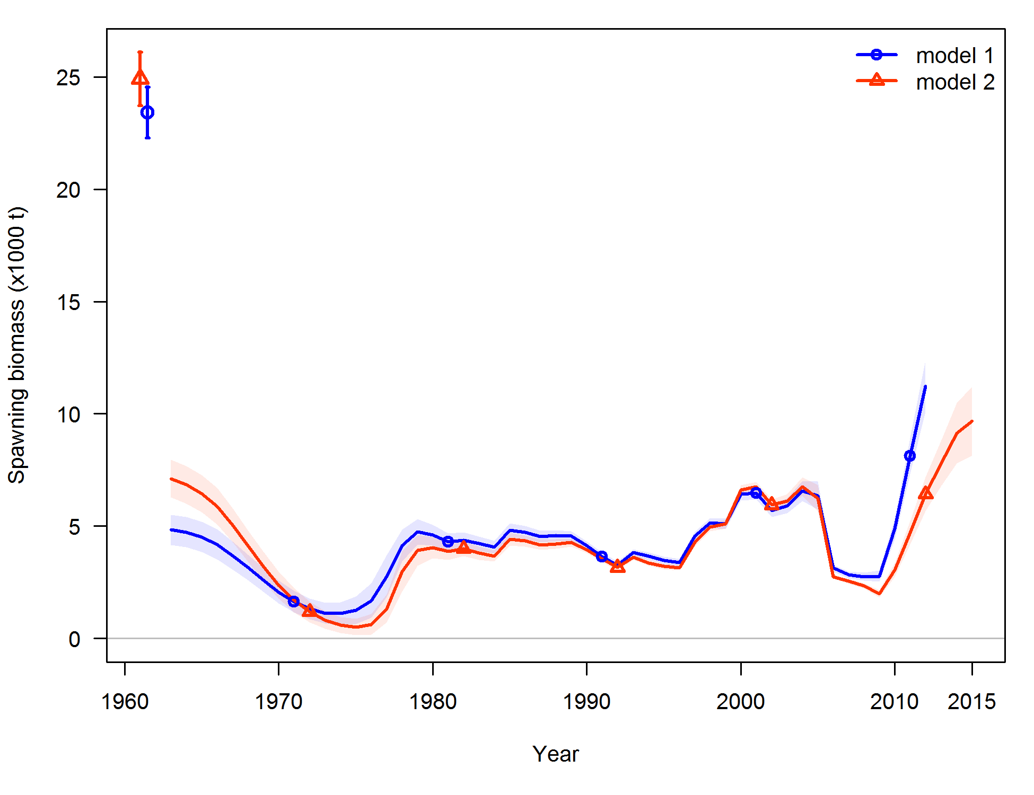
Gag Update Assessment
Blue line SEDAR 33; red line update assessment using “continuity model”
“continuity model” means using the same model as in SEDAR33 but with new data
Also a retrospective pattern

Slide 4
Gag Update Assessment
 |  | Model
 |  | Continuity
Criteria | Definition
Base M |  | 0.134
Steepness |  | 0.855
Virgin Recruitment | 1000s | 5030.8
SSB unfished | Metric tons | 24908
F_{MSY} or proxy | F_{MAX} | 0.1964
MFMT | F_{MAX} | 0.1964
F_{CURRENT} | F (nyr-3)-nyr (geometric mean) | 0.0817
F_{CURRENT}/MFMT |  | 0.416
 | Biomass criteria
SSB_{MSY} | SSB at F_{MAX} | 7171
MSST | (1-M)*SSB_{MSY} | 6210.1
SSB_{CURRENT} | SSB2015 | 9688.07
SSB_{CURRENT}/MSST | SSB2015 | 1.56
Not overfishing
Not Overfished

Slide 5
Gag Update Assessment
But still a lot of uncertainty
Table 2. Red tide sensitivity analysis
Model | Exploitation rate | Dead discards (1000s)
SEDAR 33 | 0.397 | 3405.69
Continuity | 0.39 | 3216.48
Red tide 2005 and 2014 | 0.493, 0.564 | 5075.75, 4232.08
Red tide 2005 and 2015 | 0.425, 0.492 | 6718.35, 10366.1

Slide 6
Gag Update Assessment
But still a lot of uncertainty
Table 2. Red tide sensitivity analysis
Model | Exploitation rate | Dead discards (1000s)
SEDAR 33 | 0.397 | 3405.69
Continuity | 0.39 | 3216.48
Red tide 2005 and 2014 | 0.493, 0.564 | 5075.75, 4232.08
Red tide 2005 and 2015 | 0.425, 0.492 | 6718.35, 10366.1

Slide 7
Gag Update Assessment
A lot of uncertainty
But SSC concluded that the continuity model (as prescribed by an update assessment) was still the best available science;
And
That the projected yields from that model for 2017-2019 be used for projected yield streams for determining OFL and ABC

Slide 8
Gag Update Assessment
Table 4. Projected Gag OFL and two alternative ABC yield streams, 2017-2019
Year | OFL at F_{MAX} | ABC at P* = 0.30 | ABC at 0.75*F_{MAX}
2017 | 4.68 mp gw | 4.28 mp gw | 3.59 mp gw
2018 | 4.34 mp gw | 3.99 mp gw | 3.50 mp gw
2019 | 4.18 mp gw | 3.86 mp gw | 3.52 mp gw
Equilibrium | 4.05 mp gw | 3.81 mp gw | 4.10 mp gw
OFL in left column; but SSC still had to choose an appropriate ABC method (from two right hand columns)

Slide 9
Year | OFL at F_{MAX} | ABC at P* = 0.30 | ABC at 0.75*F_{MAX}
2017 | 4.68 mp gw | 4.28 mp gw | 3.59 mp gw
2018 | 4.34 mp gw | 3.99 mp gw | 3.50 mp gw
2019 | 4.18 mp gw | 3.86 mp gw | 3.52 mp gw
Equilibrium | 4.05 mp gw | 3.81 mp gw | 4.10 mp gw
SSC felt uncertainties in update were not appropriately characterized by Tier 1 P* approach (middle column); Therefore, SSC chose rt-hand column where ABC set at 75% Fmax; both OFL and ABC for 2017 for the update are somewhat less than the 2017 OFL and ABC from before the update.
Council has maintained an ACL of 3.12 mp gw

