Slide 1
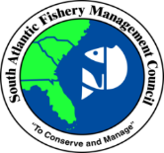
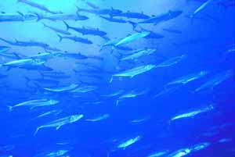
Update on Amendment 33: Gulf King Mackerel Sector Allocations
+ Review of Joint CMP FMP Objectives
CMP AP Meeting – Dec 2022

Slide 2
Draft Amendment Status
At its October 2022 meeting, the Gulf Council made a motion to cease work on this document.
The discussion surrounding the motion centered on more recent years of landings (the 2020/2021 fishing year and preliminary landings for the 2021/2022 fishing year) relative to sector ACLs, and that the data show a decrease in that ratio for both sectors.
Potential modifications to CMP objectives that were included in CMP Amendment 33 will be included in a future CMP plan amendment.

Slide 3
Gulf Council & South Atlantic Council Joint Coastal CMP FMP Objectives
Prior to discussions in 2022, the Gulf Council and the South Atlantic Council last modified the FMP objectives in CMP Amendment 6 (1992), which brought the number of objectives from 7 to 8.
NMFS Procedural Directive 01-119-02 (NMFS 2016) provides recommended practices during an allocation review, which includes a Council re-assessing the FMP objectives, if they are not current, clear, or measurable.

Slide 4
Gulf Council & South Atlantic Council Joint Coastal CMP FMP Objectives
The primary objective of this FMP is to achieve and maintain optimum yield, to allow recovery of overfished populations, and maintain population levels sufficient to ensure adequate recruitment.
To provide a flexible management system for the resource which minimizes regulatory delay while retaining substantial Council and public input in management decisions and which can rapidly adapt to changes in resource abundance, new scientific information, and changes in fishing patterns among user groups or by areas.
To minimize gear and user conflicts.

Slide 5
Gulf Council & South Atlantic Council Joint Coastal CMP FMP Objectives
To distribute the total allowable catch of Atlantic migratory group Spanish mackerel between recreational and commercial user groups based on the catches that occurred during the early to mid-1970s, which is prior to the development of the deep water run-around gillnet fishery and when the resource was not overfished.
To minimize waste and bycatch in the fishery.
To provide appropriate management to address specific migratory groups of king mackerel.
To optimize the social and economic benefits of the coastal migratory pelagic fisheries.
Notes:
At its October 2022 meeting, the Gulf Council made motions to remove the two objectives on this slide with strikethrough. The SA Council will review at its Dec 2022 meeting (Dec 5-9). The one for ‘specific migratory groups’ is considered to be ‘no longer supported by science’, per the Gulf Council’s motion; it was originally included b/c at least two king mackerel groups were thought to be in the Gulf, with a mixing zone between TX and AL (see CMP AM #5).

Slide 6
Gulf Council & South Atlantic Council Joint Coastal CMP FMP Objectives
To achieve robust fishery reporting and data collection systems across all sectors for monitoring the coastal migratory pelagic fishery which minimizes scientific, management, and risk uncertainty.
Notes:
#8 is new in 2022 – mirrors one of the Reef Fish FMP Objectives.

Slide 7
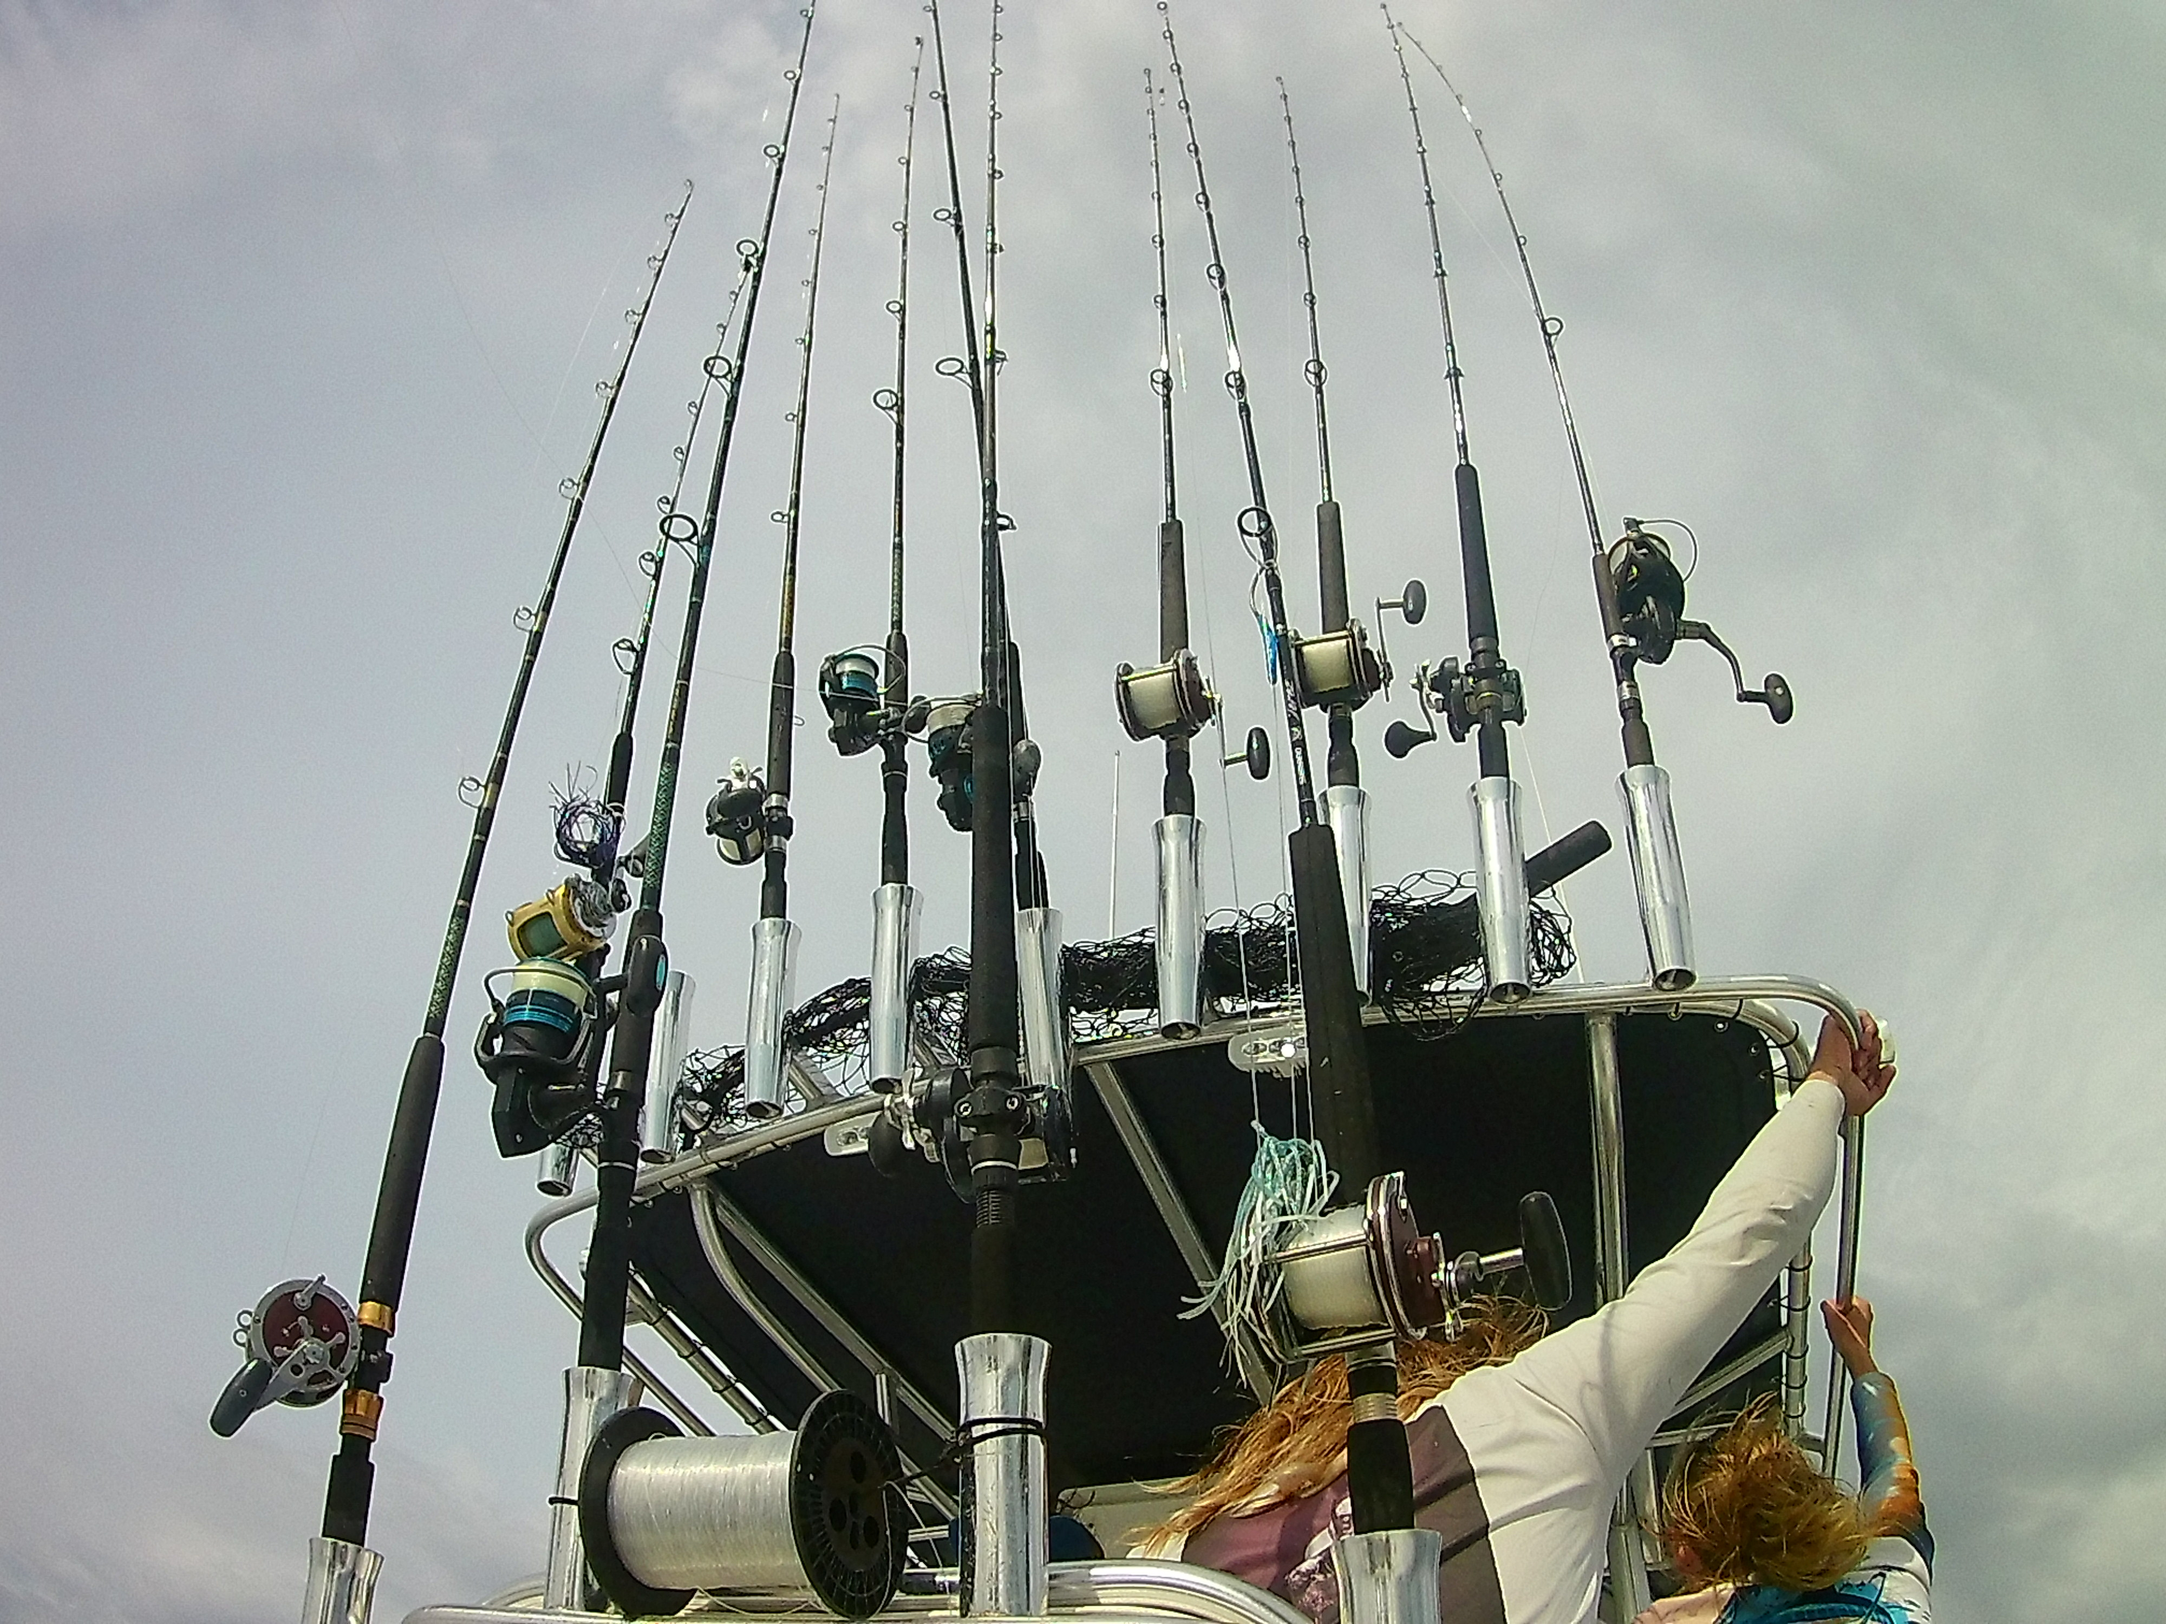
Questions? Other edits to objectives?

