Slide 1
RESTORE – Proposed Project/Draft announced on March 22, 2021
Pilot implementation of AIS in the GOM state- permitted shrimp fishery to better understand nearshore/inshore fishing effort to reduce sea turtle bycatch

Slide 2
GOM Shrimp Effort Data Collection
Automatic Identification System (AIS):
Automatic tracking technology that uses transponders on vessels to collect information - speed, and course, at regular intervals via local (<40 m) receivers operated USCG, and via satellites.
Vessel name and VHF call sign, is programmed when installing the equipment and is also transmitted regularly
The original purpose of AIS was solely collision avoidance - safety
AIS classes required
A-commercial/shipping >65ft , towing, passenger vessels-150
B-fishing vessels >65ft (most federal shrimp fleet)

Slide 3
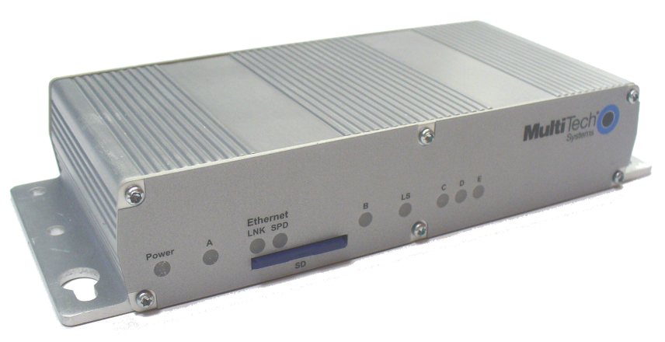
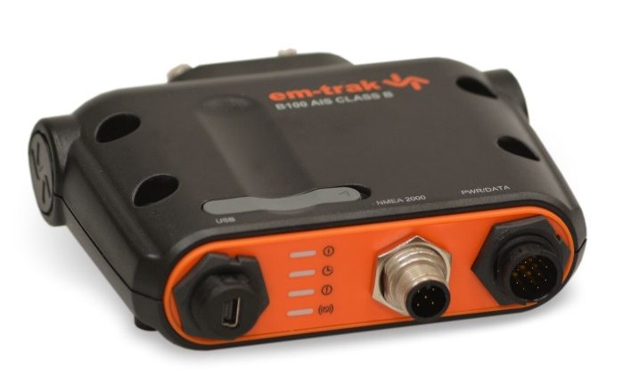
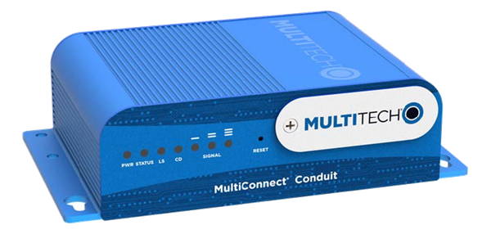
Data Collection Transmitter Technology
AIS , cELBs, VMS (reef/rock) – means of collection
3G cELB
AIS
4G cELB

Slide 4
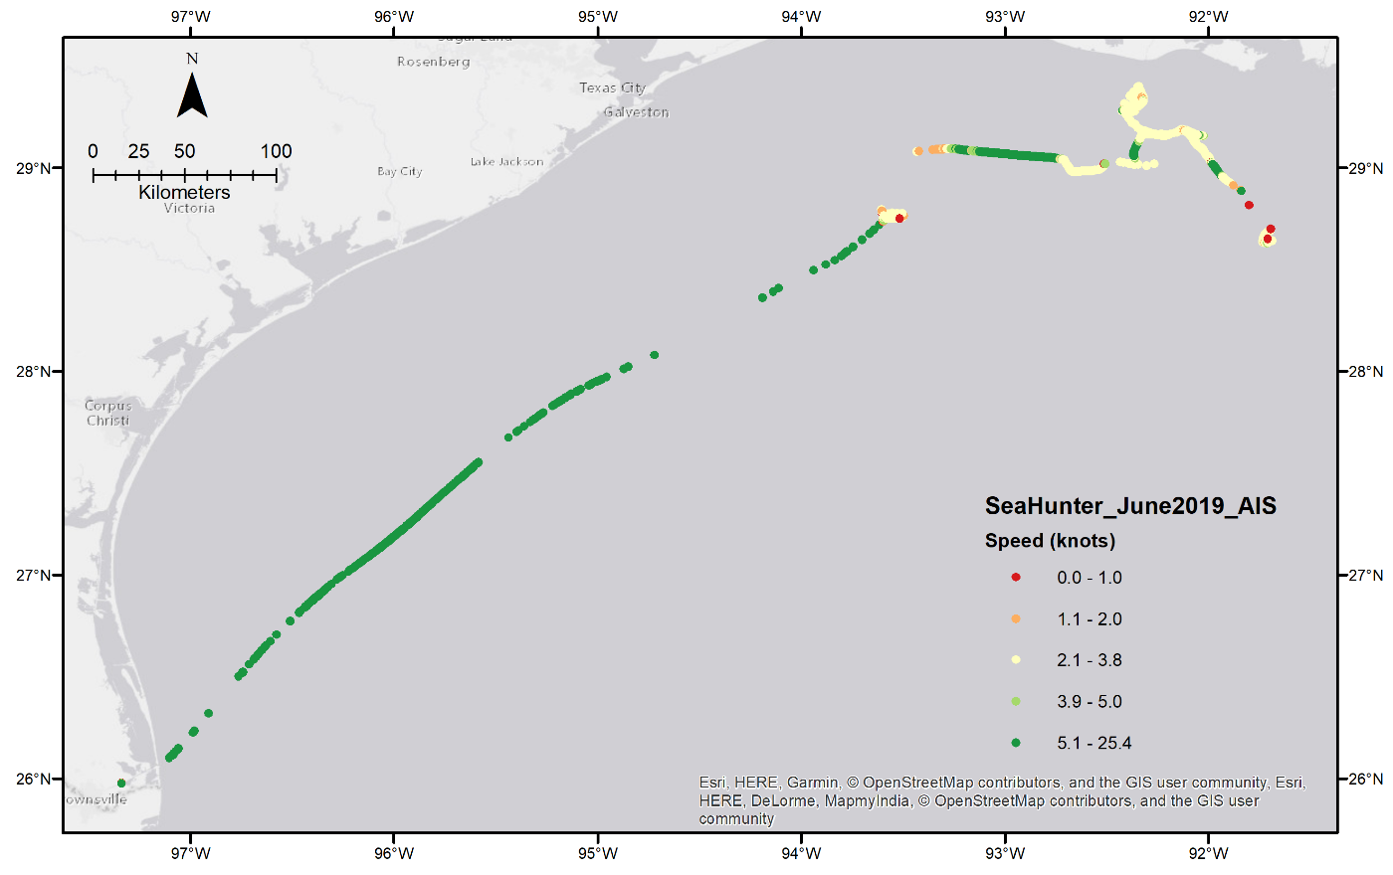
Comparison
cELB
AIS
US Department of Transportation system

Slide 5
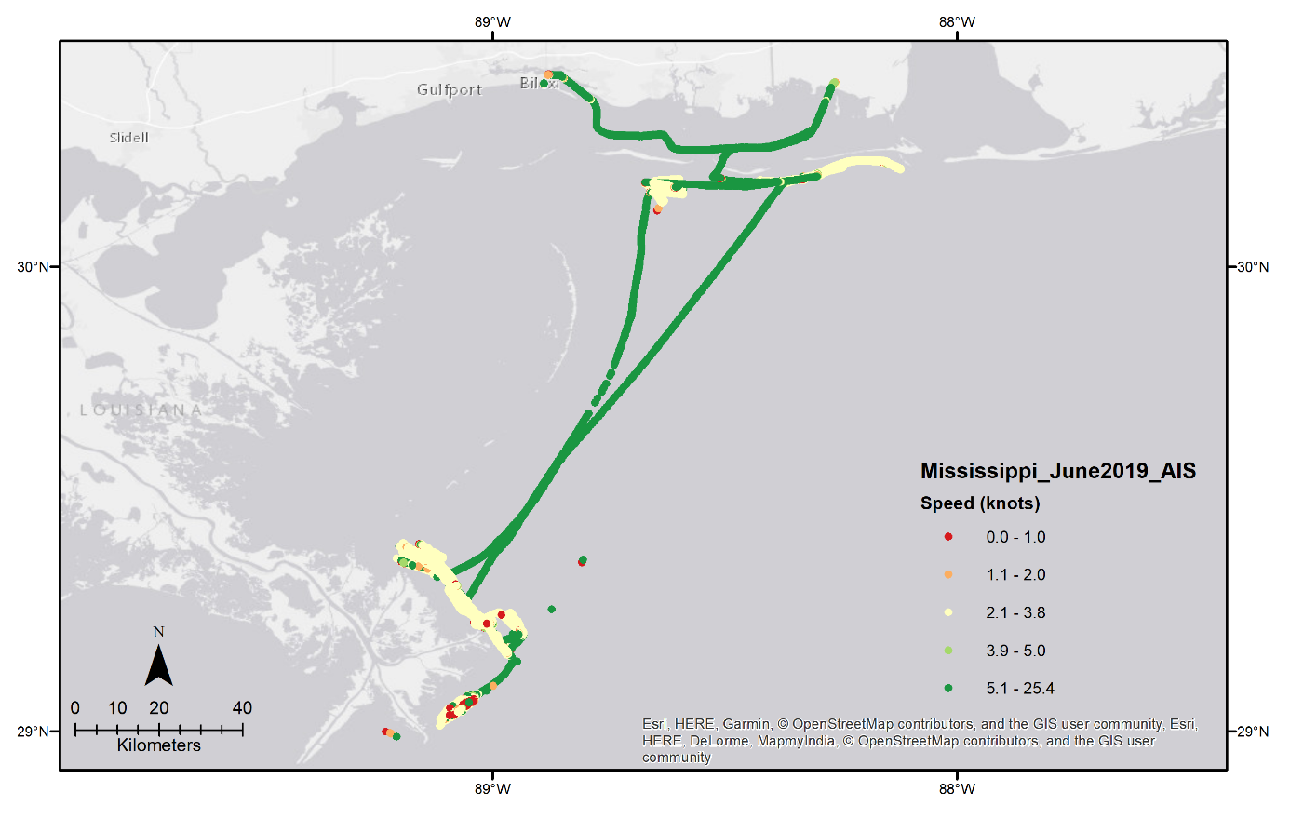
Comparison
cELB
AIS

Slide 6
Goal: test AIS class B on inshore/nearshore in Gulf state-permitted shrimp vessels (otter and skimmer)* Purpose: guide future restoration planning, enhance GMT efforts to reduce sea turtle bycatch
Implementing: voluntary portion of state-permitted vessels (state managers)
Project Funding: pays for the AIS unit cost and installation
More Information: Sara Wissmann - NOAA
Sara.wissmann@noaa.gov
301-427-8446 • Work

